Slide 1

Predicting Online Gaming Behavior Using Machine Learning to Understand Player Engagement and Behavior Patterns
Mike Saunders, Lonnie Aldredge
Ohio State University | September 2024

Slide 2

Agenda
Overview
Data Set Review
Project Objectives
Models To Evaluate
Model Results
Lessons Learned

Slide 3

Overview
Goal of this project is to predict online gaming behavior of players.
Machine learning using various classification models will be trained and tested on player data.
The best models were optimized to improve accuracy.

Slide 4
Online Gaming Behavior Dataset
Source: https://www.kaggle.com/datasets/rabieelkharoua/predict-online-gaming-behavior-dataset/data
Features:
PlayerID: Unique identifier for each player.
Age: Age of the player.
Gender: Gender of the player.
Location: Geographic location of the player.
GameGenre: Genre of the game the player is engaged in.
PlayTimeHours: Average hours spent playing per session.
InGamePurchases: Indicates whether the player makes in-game purchases (0 = No, 1 = Yes).
GameDifficulty: Difficulty level of the game.
SessionsPerWeek: Number of gaming sessions per week.
AvgSessionDurationMinutes: Average duration of each gaming session in minutes.
PlayerLevel: Current level of the player in the game.
AchievementsUnlocked: Number of achievements unlocked by the player.
EngagementLevel: Categorized engagement level reflecting player retention ('High', 'Medium', 'Low’).
File size: 2.85MB, 40034 Entries

Slide 5
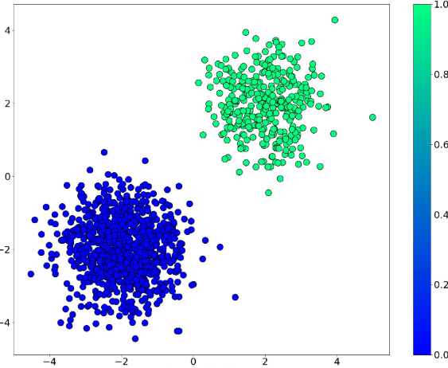
Project Objectives
Build multiple models and compare accuracy
Goal of at least 75% classification accuracy
Fit each model with training data and evaluate them using test data
Optimize the best models to improve performance
Build an additional dataset representing Mike & Lonnie’s (+ class members) online profile
Predict their engagement level

Slide 6

Processing Data
In order to consistently prepare data, we had to develop a process that took original data and converted to a data frame that is better suited for use with the models.
We created a prep_df function
Sort
Scale
One Hot Encoder
Concatenate

Slide 7
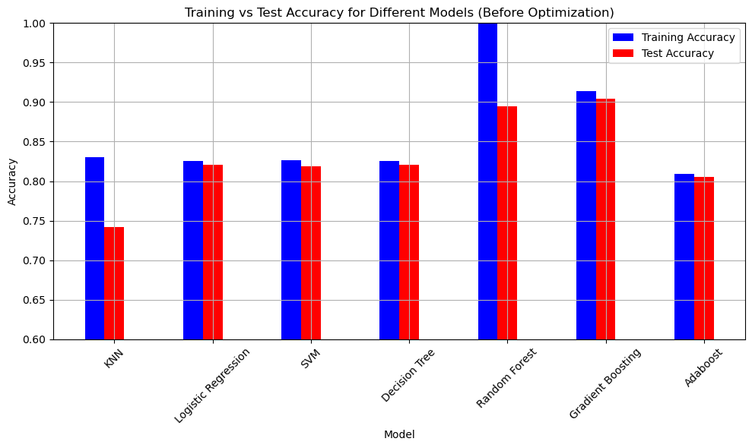
Models Evaluated
KNN
Logistic Regression
SVM
Decision Tree
Random Forest
Gradient Boosting
Adaboost

Slide 8
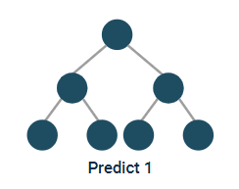
Models With Highest Scores (Before Optimization)
Random Forest
Gradient Boosting
Description | knn | lr | svm | dt | rf | gb | ab
train_acc | 0.830741 | 0.825079 | 0.826211 | 0.825079 | 1 | 0.913439 | 0.809359
test_acc | 0.741732 | 0.820861 | 0.818763 | 0.820861 | 0.894795 | 0.903887 | 0.805375
diff | 0.089009 | 0.004218 | 0.007448 | 0.004218 | 0.105205 | 0.009552 | 0.003984
r2 | 0.19593 | 0.49583 | 0.49149 | 0.49583 | 0.65323 | 0.69244 | 0.39225
mse | 0.5553 | 0.3482 | 0.3512 | 0.3482 | 0.2395 | 0.2124 | 0.4197
rmse | 0.7452 | 0.5901 | 0.5926 | 0.5901 | 0.4894 | 0.4609 | 0.6478

Slide 9
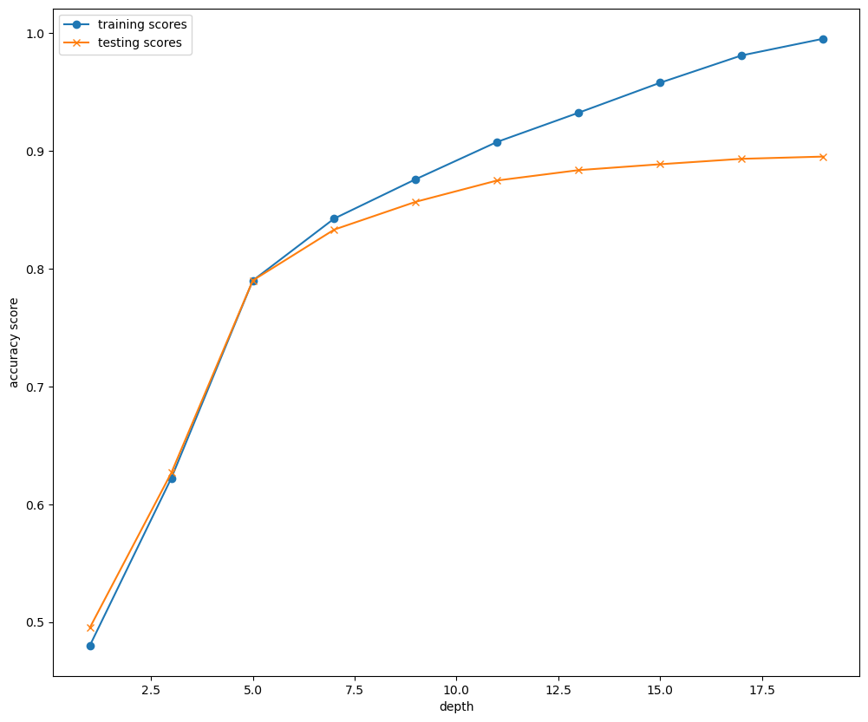
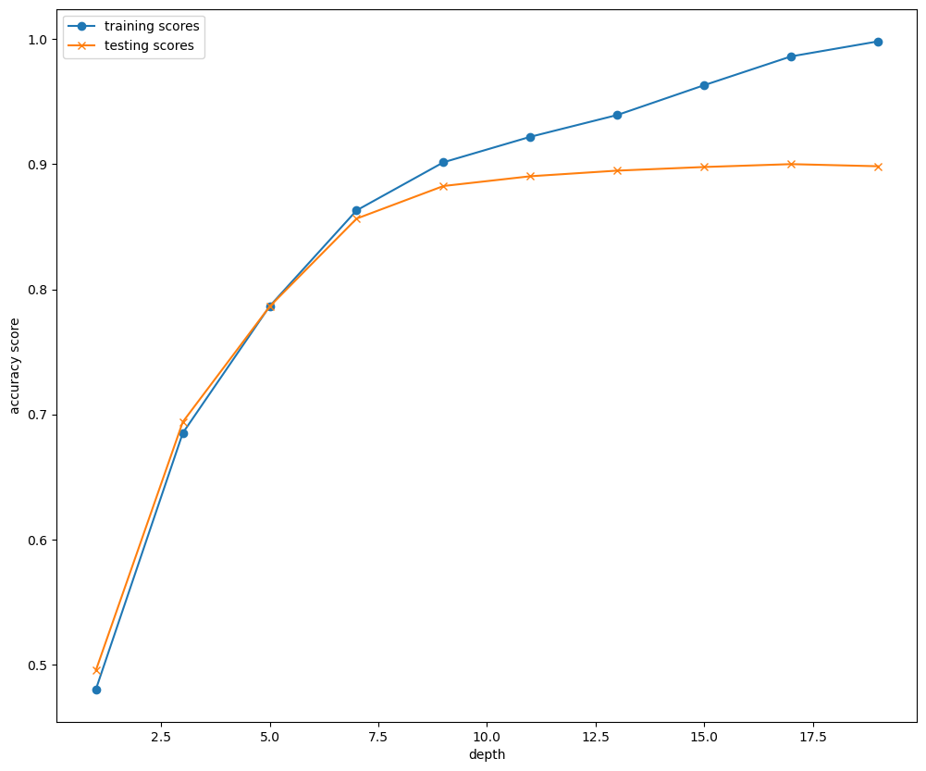
Random Forest Optimization
Random Forest Knee Plot
Random Forest Knee Plot
11 Looks Optimal
Criterion = ‘entropy’, 11 still looks optimal
*Other criterial evaluated log_loss & gini

Slide 10
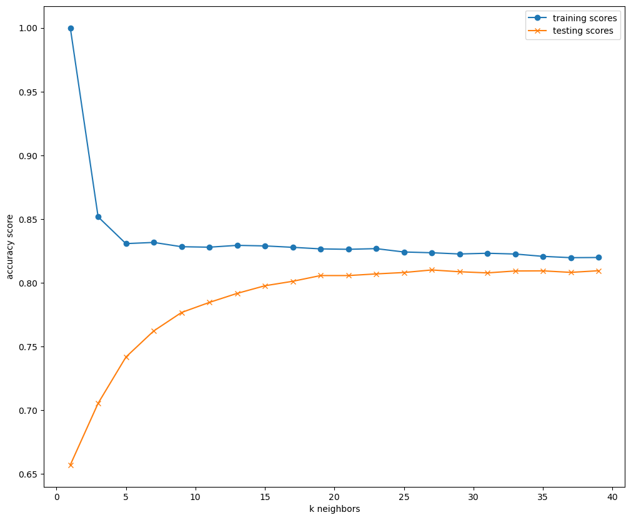
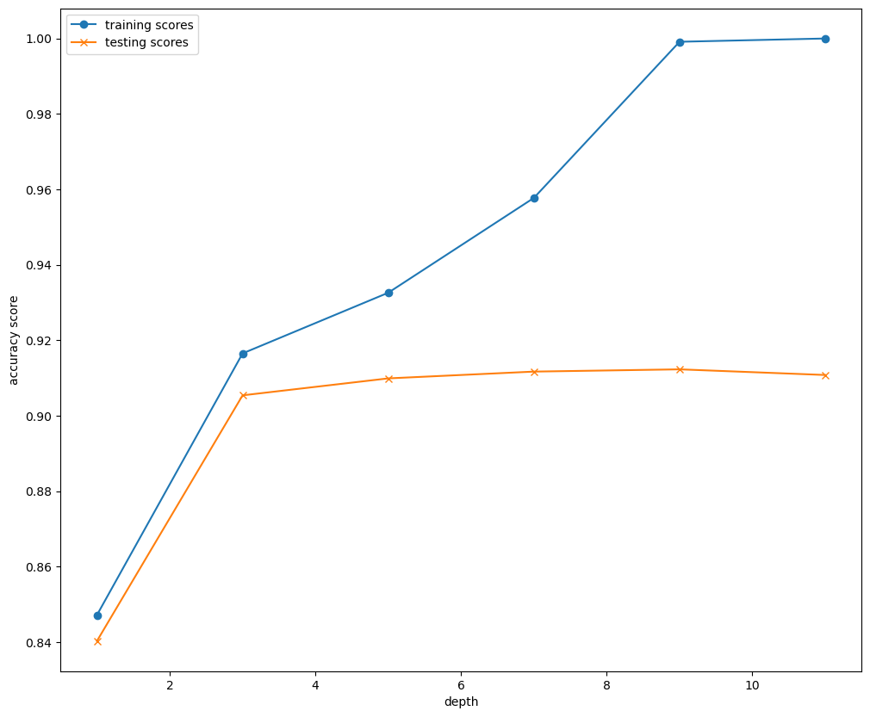
Gradient Boosting & KNN Optimization
Gradient Boosting Knee Plot
KNN Plot
3 Looks Optimal
27 Looks Optimal

Slide 11
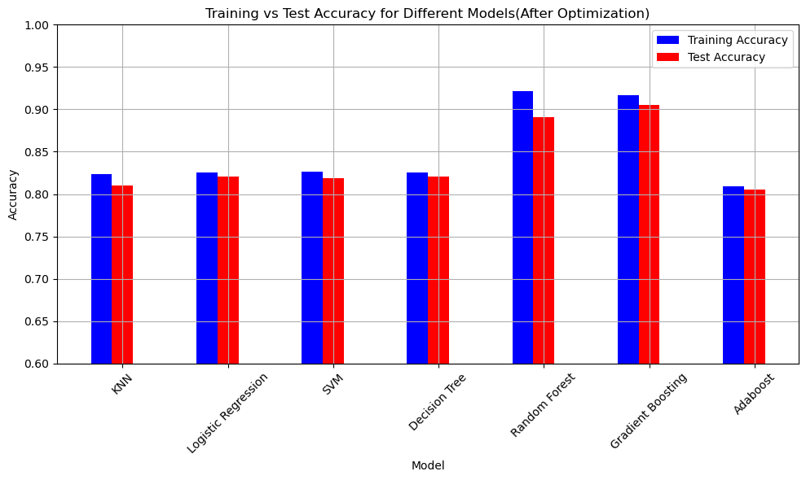
Models With Highest Scores (After Optimization)
Random Forest
n_estimators=128, max_depth=11, criterion=‘entropy’
Gradient Boosting
max_depth=3, n_estimators=128
Description | knn | lr | svm | dt | rf | gb | ab
train_acc | 0.82358 | 0.825079 | 0.826211 | 0.825079 | 0.921965 | 0.916503 | 0.809359
test_acc | 0.810071 | 0.820861 | 0.818763 | 0.820861 | 0.890399 | 0.905385 | 0.805375
diff | 0.013509 | 0.004218 | 0.007448 | 0.004218 | 0.031566 | 0.011118 | 0.003984
r2 | 0.44245 | 0.49583 | 0.49149 | 0.49583 | 0.63949 | 0.69634 | 0.39225
mse | 0.3851 | 0.3482 | 0.3512 | 0.3482 | 0.249 | 0.2097 | 0.4197
rmse | 0.6206 | 0.5901 | 0.5926 | 0.5901 | 0.499 | 0.4579 | 0.6478

Slide 12
Evaluating Models Using Class Member Profiles
Name | Age | Gender | Location | GameGenre | PlayTimeHours | InGamePurchases | GameDifficulty | SessionsPerWeek | AvgSessionDurationMinutes | PlayerLevel | AchievementsUnlocked
Mike S. | 57 | Male | USA | Action | 1.5 | 0 | Medium | 5 | 30 | 10 | 8
Lonnie | 49 | Male | USA | RPG | 6 | 0 | Medium | 5 | 180 | 20 | 50
Joe | 47 | Male | USA | Sports | 1 | 0 | Easy | 0.001 | 30 | 1 | 0
Mike | 42 | Male | USA | Strategy | 1 | 0 | Hard | 6 | 60 | 0 | 0
Ryan | 24 | Male | USA | Sports | 1 | 0 | Medium | 4 | 45 | 5 | 10
Chelsey | 36 | Female | USA | Strategy | 1 | 0 | Hard | 5 | 30 | 0 | 0
Ronald | 36 | Male | USA | RPG | 0 | 0 | Hard | 0 | 0 | 0 | 0
Giselle | 34 | Female | USA | Strategy | 0 | 0 | Easy | 0 | 0 | 0 | 0
Model | Mike S. | Lonnie | Joe | Mike | Ryan | Chelsey | Ronald | Giselle
KNN | Low | Medium | Low | Low | Low | Low | Low | Low
LR | Low | Medium | Low | Low | Low | Low | Low | Low
SMV | Low | Medium | Low | Low | Low | Low | Low | Low
DT | Low | Medium | Low | Low | Low | Low | Low | Low
RF | Low | Medium | Low | Medium | Low | Low | Low | Low
GB | Low | Medium | Low | Medium | Low | Low | Low | Low
AB | Medium | Medium | Low | Medium | Medium | Medium | Low | Low

Slide 13
Problems Encountered When Running Mike & Lonnie
First pass at creating categorial variables for features used get_dummies
Class member profiles did not have all features in dataset, and thus resulting dataset was missing columns
Could not use to predict values
Solution was to use OneHotEncoder. This gave us the ability to create categorial indicators with all the needed columns

Slide 14
Future Development
Given more time we would research additional models
Develop a GUI for data entry and prediction results
GUI – Graphical User Interface

